Slide 1
Ansible and Juju sitting in a tree
Charmer Summit 2016 - Gent

Slide 2
I know
Puppet
Ansible
and I want to model my application in Juju.
Notes:
The concepts we look at today, will be available to you regardless of the tooling you have expertise in.

Slide 3
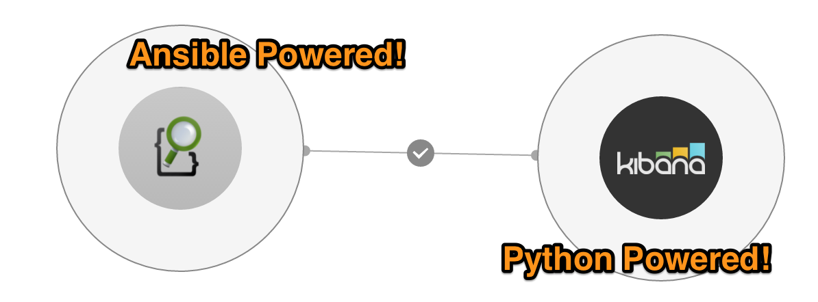
Combine all the things!
Ansible does a great job of configuring machines.
Juju does an excellent job of modelling applications.
Notes:
enriching ansible with relations to illustrate

Slide 4
What is a charm?
Charms encapsulate operational knowledge; such as how to deploy, configure, and manage an application.
Additionally, they define how applications communicate with one another.
Notes:
Charms are the building blocks in which you are able to express an applications model

Slide 5
Components of a Charm
metadata.yaml - defines a charms properties, such as which relations and interfaces it implements, tags, description, and name
Reactive Modules - Executeable code to “react” to the event states that are present/missing during charm hook execution.
Configuration - Share common configuration among units as an application scales out
Relations & Interfaces - declare how an application will communicate and interact with its peers

Slide 6
Where does Ansible fit in?
Hooks call Ansible to execute plays tagged with reactive states
Ansible loads configuration data, and unit data - then begins execution.
All of your juju config and relation-data are available as template variables within your playbooks and templates
Notes:
3 powers of juju generate events that you can subscribe to
Application Configuration, Application Lifecycle events, Application communication events

Slide 7
Only manage YOUR deltas
Notes:
Tap into a community of expertise, and assemble your charm from layers published by the charming community. Building charms from layers reduces your fatigue during charming, by allowing you to only focus on your deltas. Keeping your top layer crisp, clean, and focused on the events that matter most to your workload.

Slide 8
Managing YOUR deltas
|-- config.yaml
|-- layer.yaml
|-- metadata.yaml
|-- playbook.yaml
|-- reactive
`-- elasticsearch.py

Slide 9
Lets dig in!

Slide 10
Any Questions?

Slide 11
Everything explained today is available here:
Charm Base layer for Ansible Charms https://github.com/chuckbutler/ansible-base
Charm Library for interacting with Ansible
https://github.com/chuckbutler/charms.ansible
Consuming layer based on ansible-base
https://github.com/chuckbutler/layer-elasticsearch

